Slide 1

FFF(Food For Free)
Changsi Liu, Qian Liao, Xiaohan Zhao

Slide 2
Problem Statement
The project is a food distribution system designed to improve food stamp plans. The existed Health and Human Services system can only manage plans and show personal information assigned under a plan. Other information like food service center locations, food supplier and storage, volunteer work, etc. were not included or in other system.

Slide 3
Approach
Support all involved users’ accesses to form a ecosystem
Set up links between government and food banks, government and suppliers, food banks and suppliers, food banks and agents
Add volunteer to the distribution process
Set government as singleton pattern
Monitor the system operation conditions to realize data analysis

Slide 4
Object Model

Slide 5
User Cases&Actors
System Admin Role:
Manage networks, assign one government account to one network
Government Role:
Manage plans and plan benefits, approve suppliers and benefit applications
Manage food catalog. Monitor plan analysis
User Role (For benefit people):
Apply for a specific plan. Revoke his/her plan to change a plan
Check own monthly plan benefits
Supplier Role:
Apply to be an authorized supplier
Manage supplier’s organization/ employee/ account

Slide 6
Food Bank Role:
Manage service agents assigned under food bank.
Manage foodbank’s organization/ employee/ account
Agent Role:
Manage agent’s . organization/ employee/ account
Inventory Role:
Suppliers’ inventory: Collect and fit food requests from food banks.
Food banks’ inventory: Post request between food banks. Post request to supplier, ask for more food supply.
Agents’ inventory: Post request to its assigned food bank
Service Role:
Search benefited person’s plan information by provide SSN
Checkout benefit people’s shopping cart

Slide 7
Government
Apply a Plan
Approve/ Deny
Register as a user
User(Benefit person)
Approved
Denied
Check My Plan
View Benefit History
Apply Again

Slide 8
Government
Request to be authorized
Approve/ Deny
Register as a supplier
Supplier
approved
Denied
Manage Organization
Add Inventory
…
Request Again

Slide 9
Supplier
Food
Food Request
Food
Food Bank B
Food Bank A
Food Request
Food
Food Request
Agent

Slide 10
System Flow

Slide 11
Screenshots

Slide 12
System Admin Role
System admin can add network. Each network has one government account. (Singleton design pattern)

Slide 13
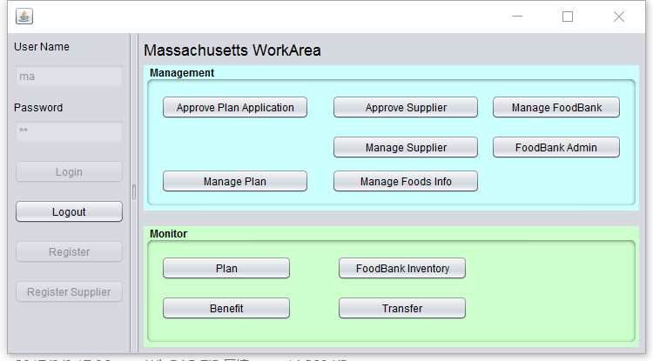
Government Role
Government can create special plans and manage people in the plan
Manage all food bank under the government
Government can see the plans’ performance
Government can authorized suppliers and give the food a standard price

Slide 14
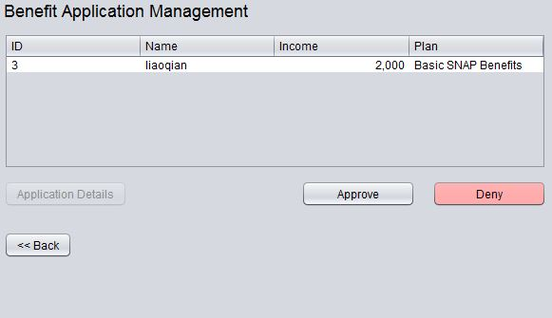
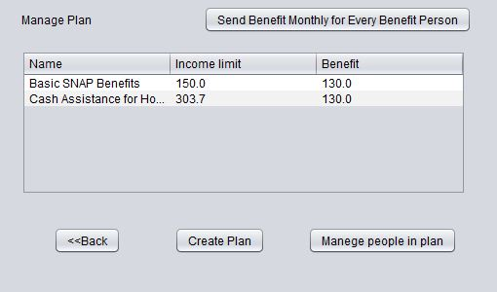
Approve users’ applications to a plan
Every month the government send the plans’ benefit to benefit people
Manage plans

Slide 15
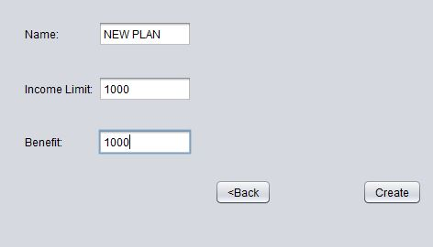
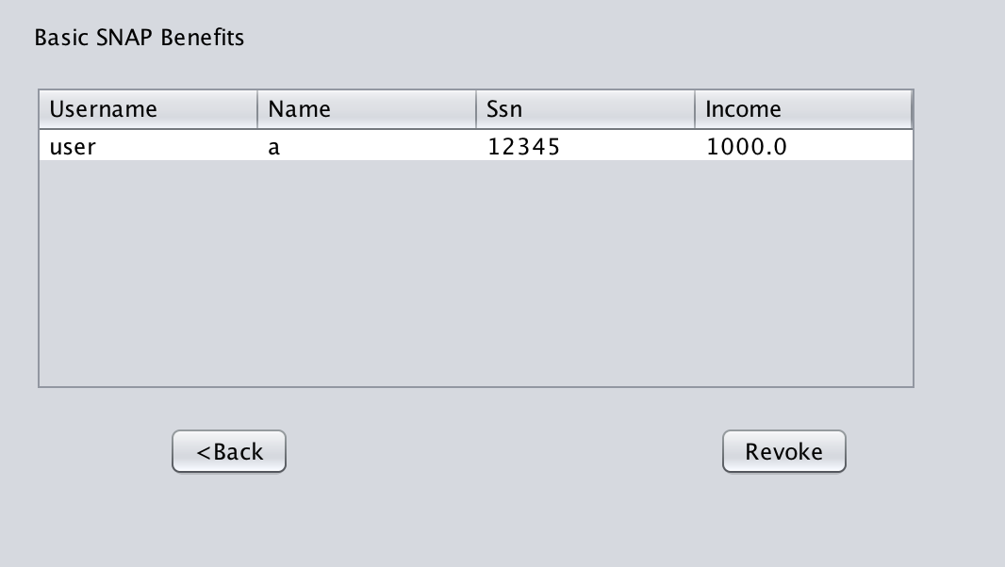
Create a plan
Manage benefit people in a selected plan

Slide 16
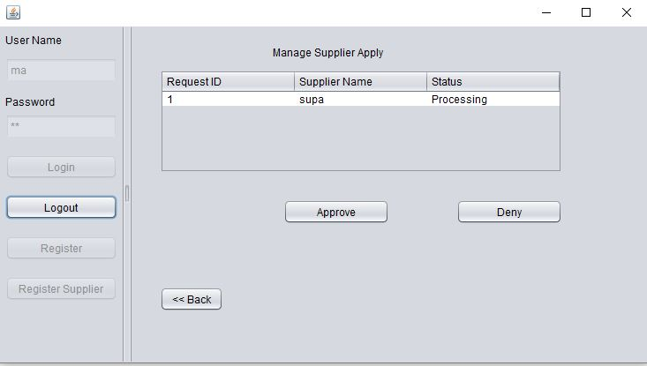
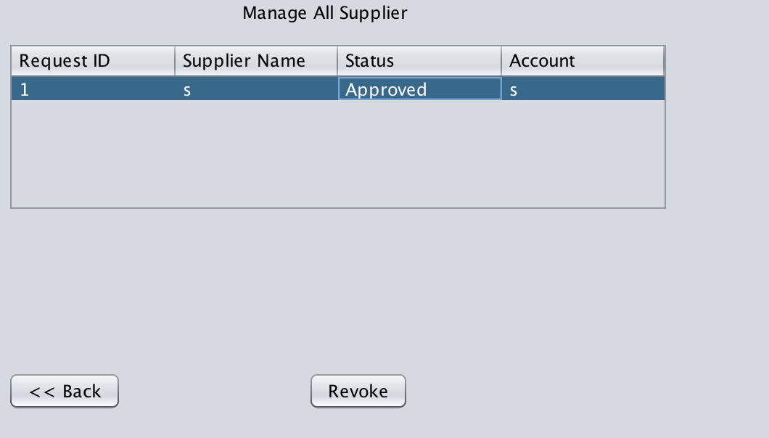
Approve suppliers
Manage suppliers
Manage food catalog

Slide 17
Manage food bank
Create food bank admin

Slide 18
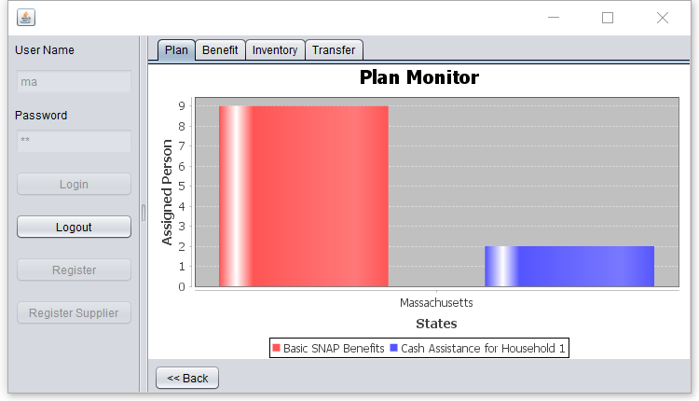

Slide 19
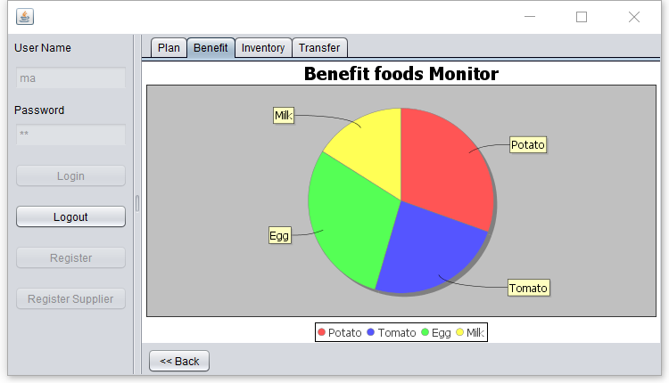

Slide 20
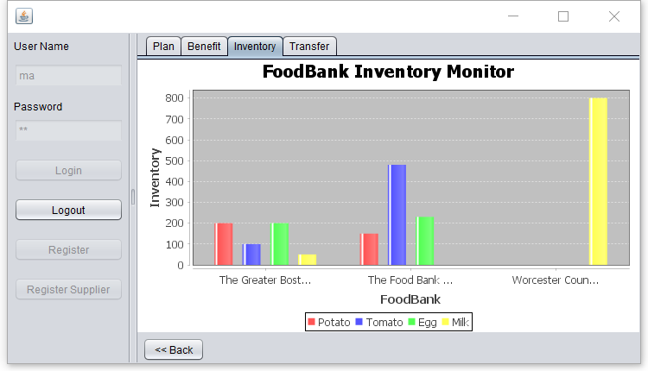

Slide 21
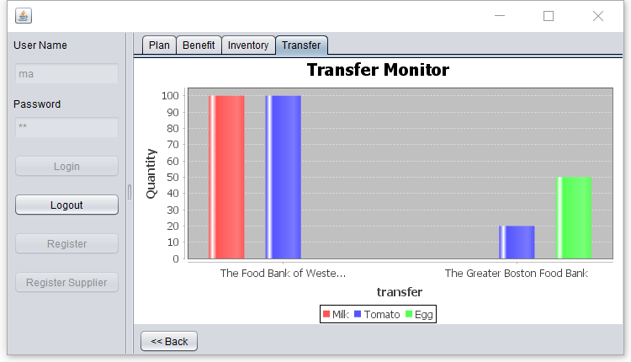

Slide 22
Supplier Role
Register as a supplier
Apply to be a authorized supplier

Slide 23
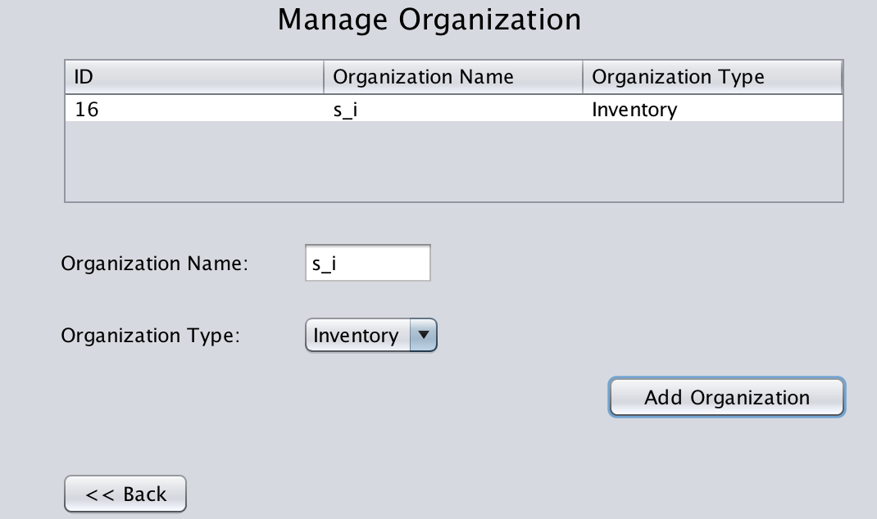
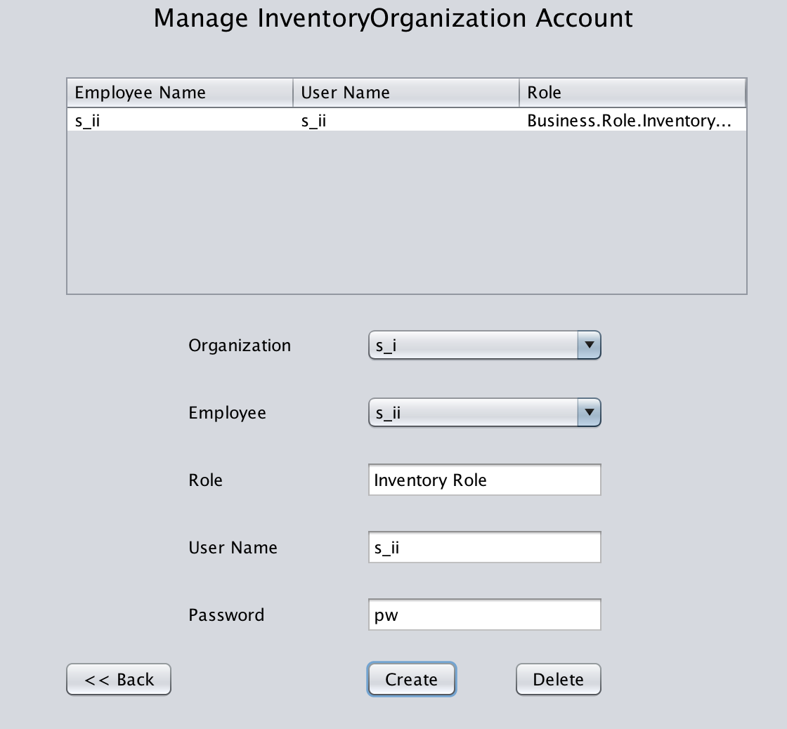
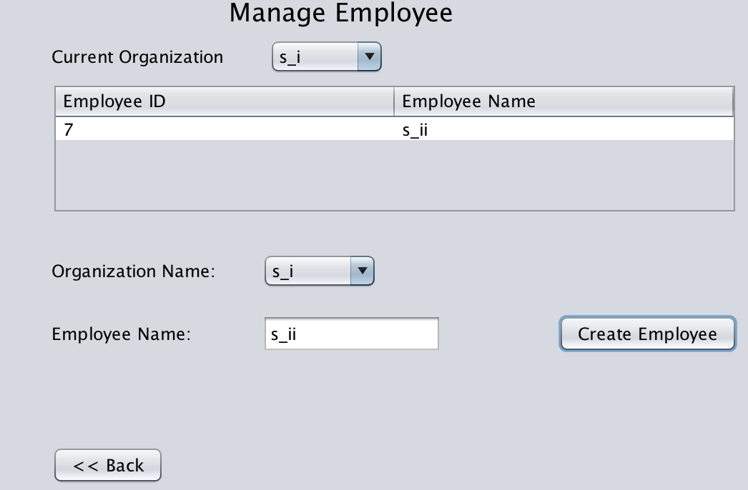
Manage supplier’s organizations, employees and accounts

Slide 24
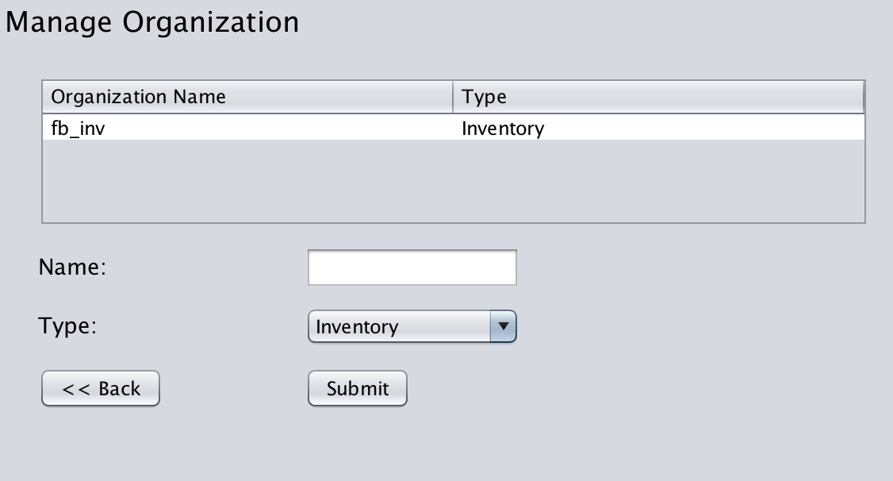
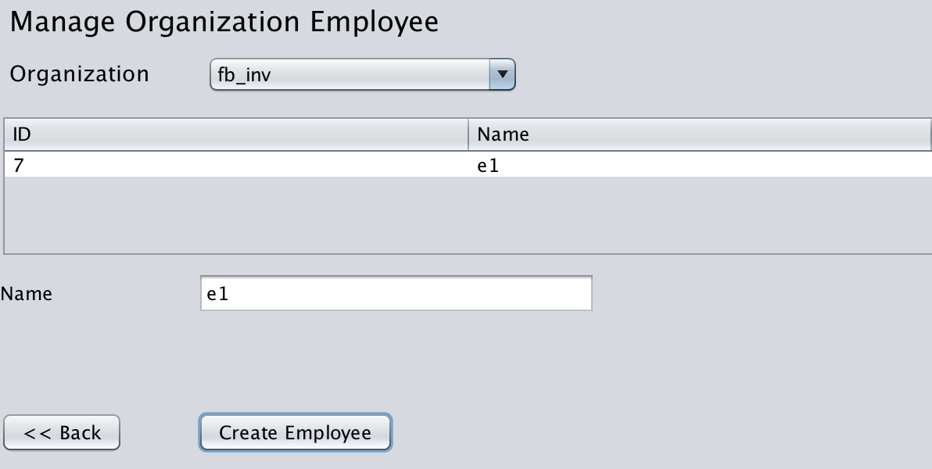
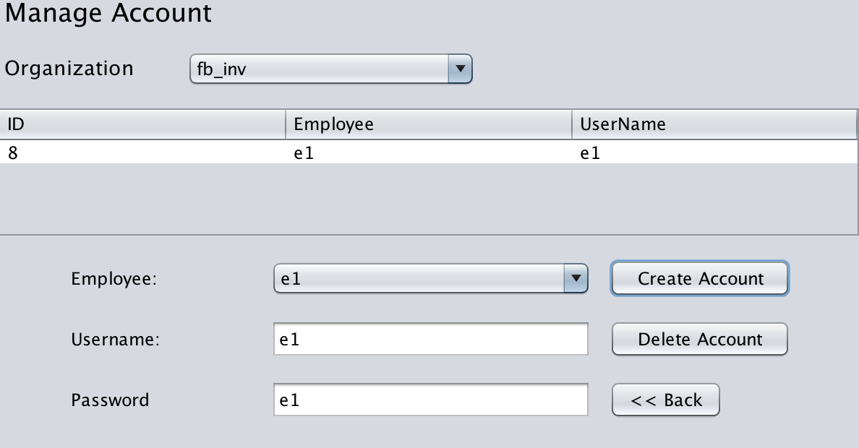
FoodBank Role

Slide 25
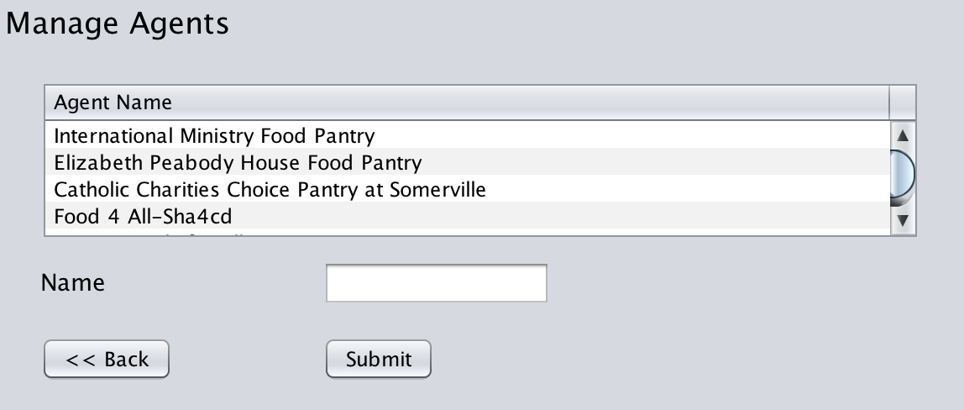
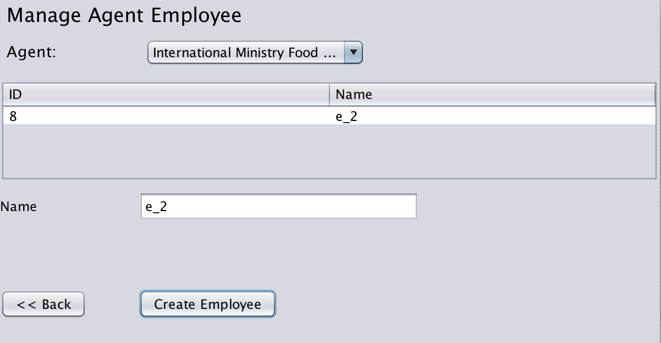
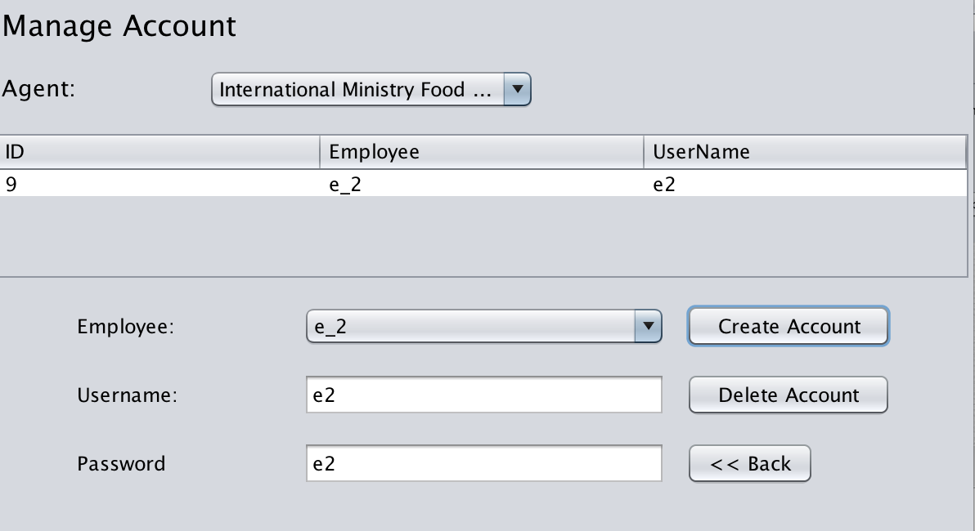
Food bank manage its agents under it and give its access to its employee

Slide 26
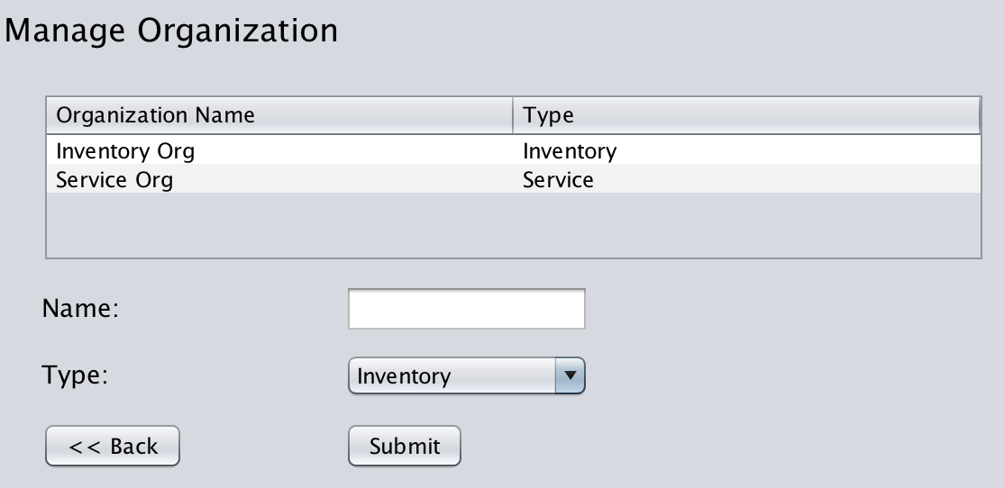
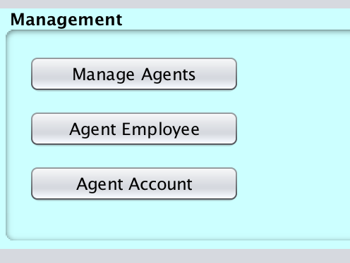
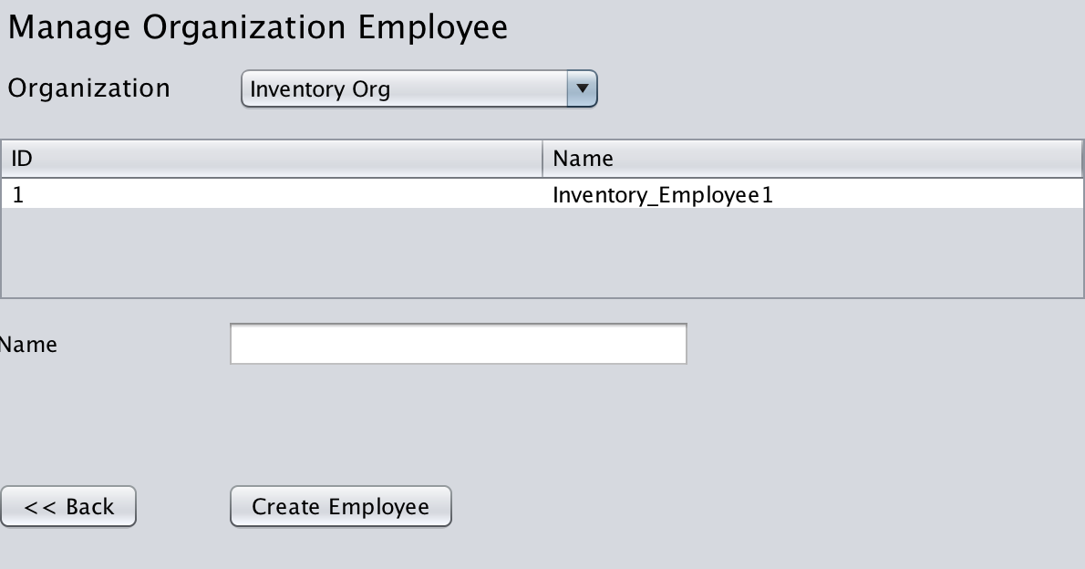
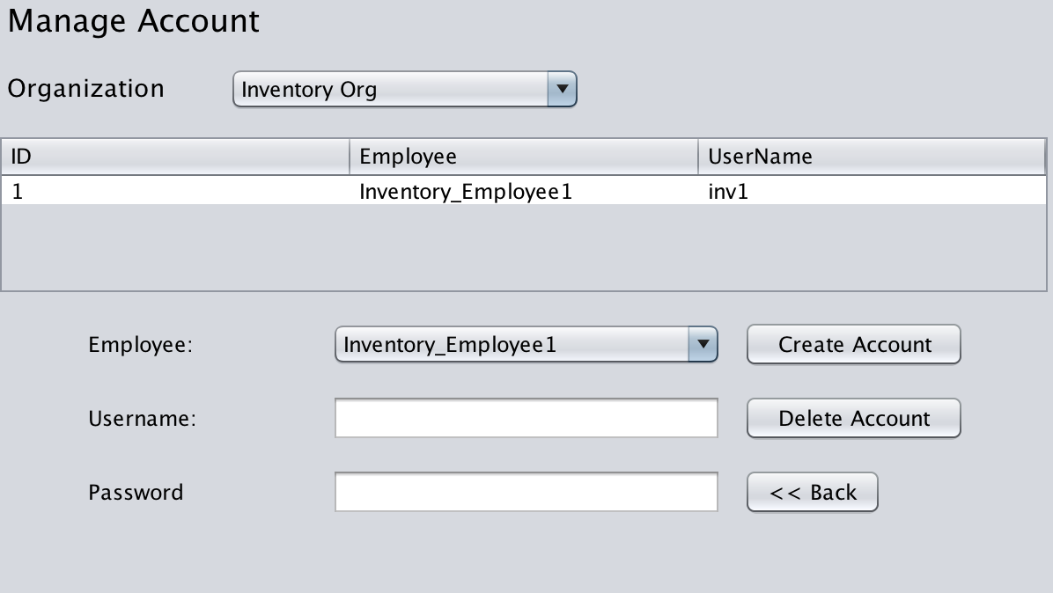
Agent Role
Agent role can manage its own organizations’ employees

Slide 27
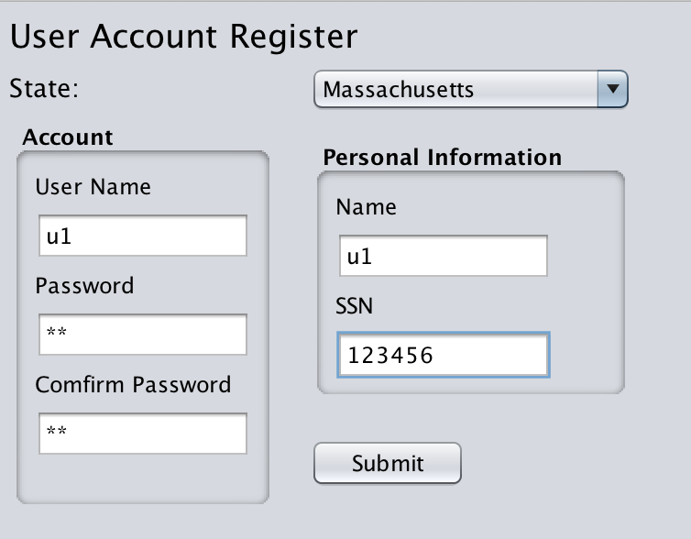
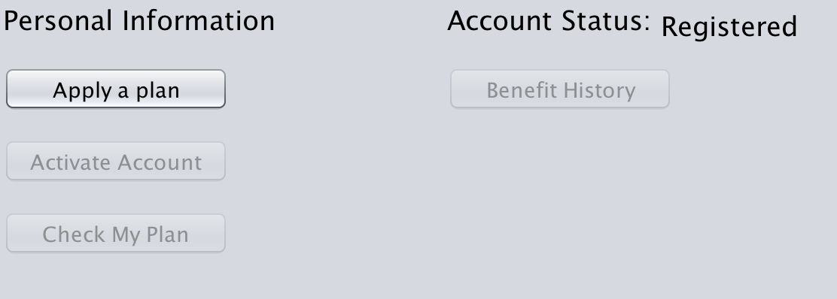
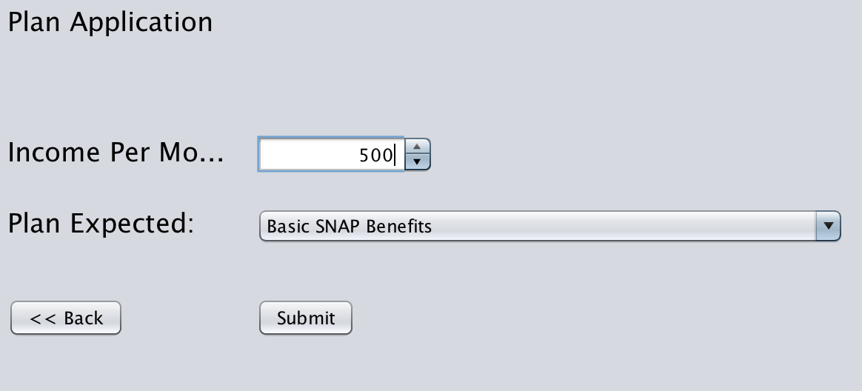
User Role(for benefit people)
People can submit information to government to apply for a plan

Slide 28
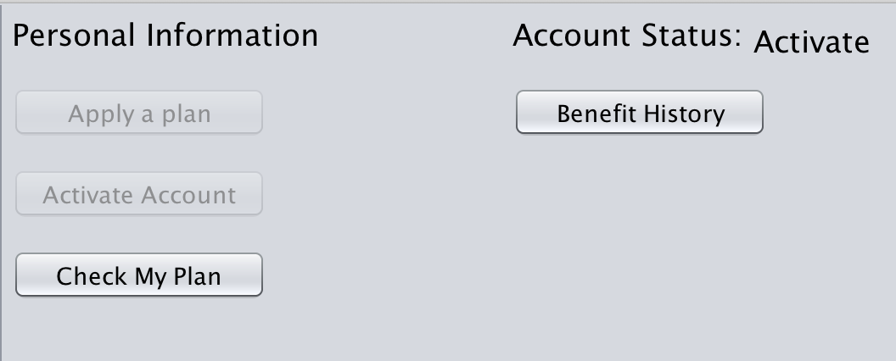
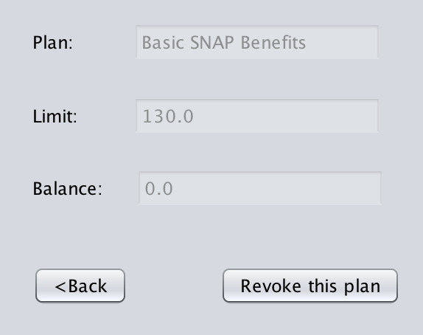
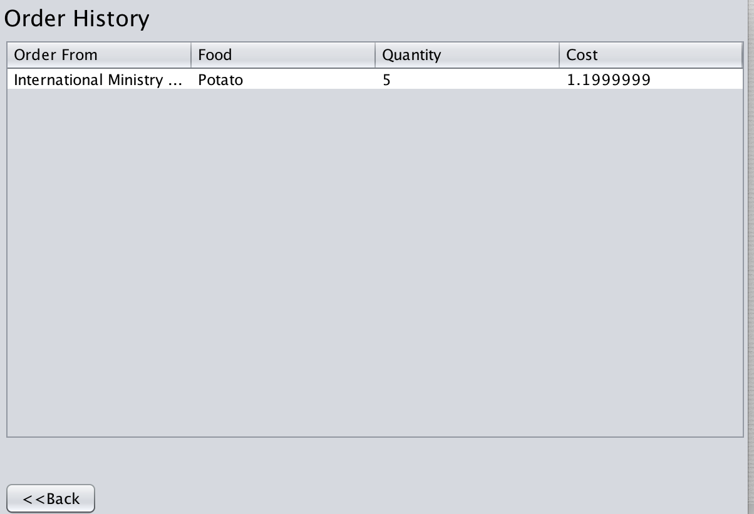
If one revokes this plan, then user can apply another plan

Slide 29
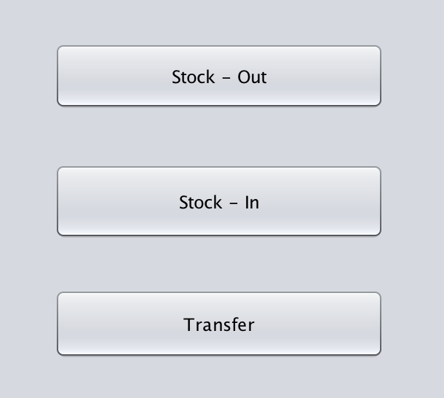
Inventory Role
Every inventory role can manage own inventory. Agent can request inventory from the food bank assigned to it. Food bank request inventory from all suppliers or another food bank.

Slide 30
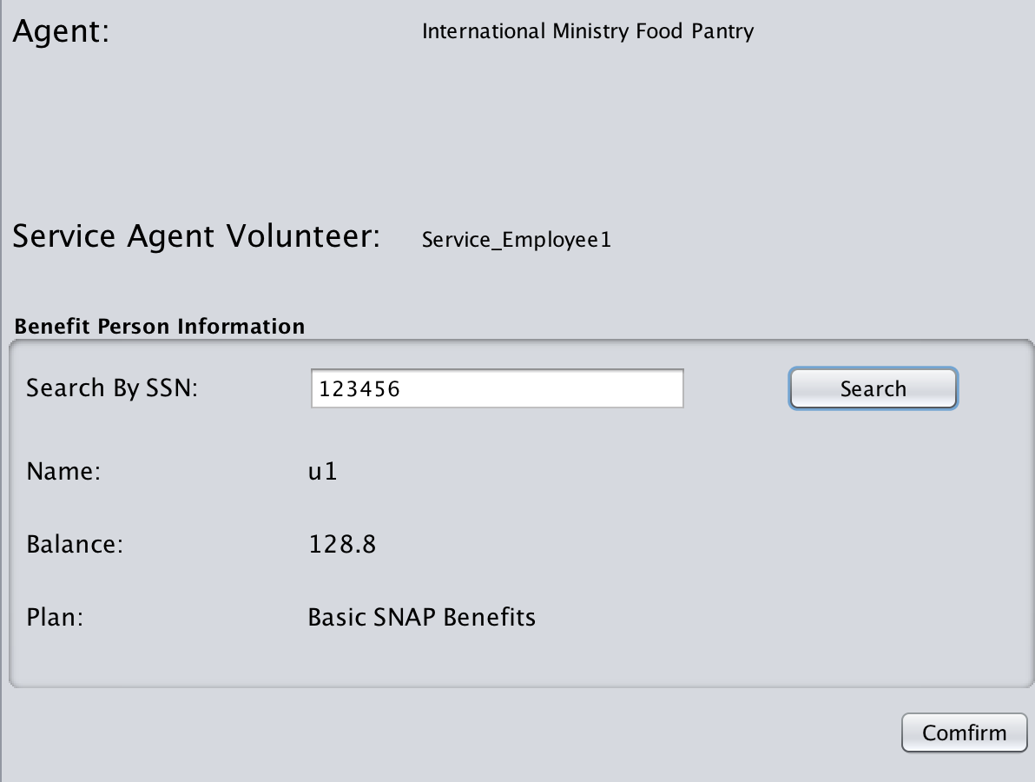
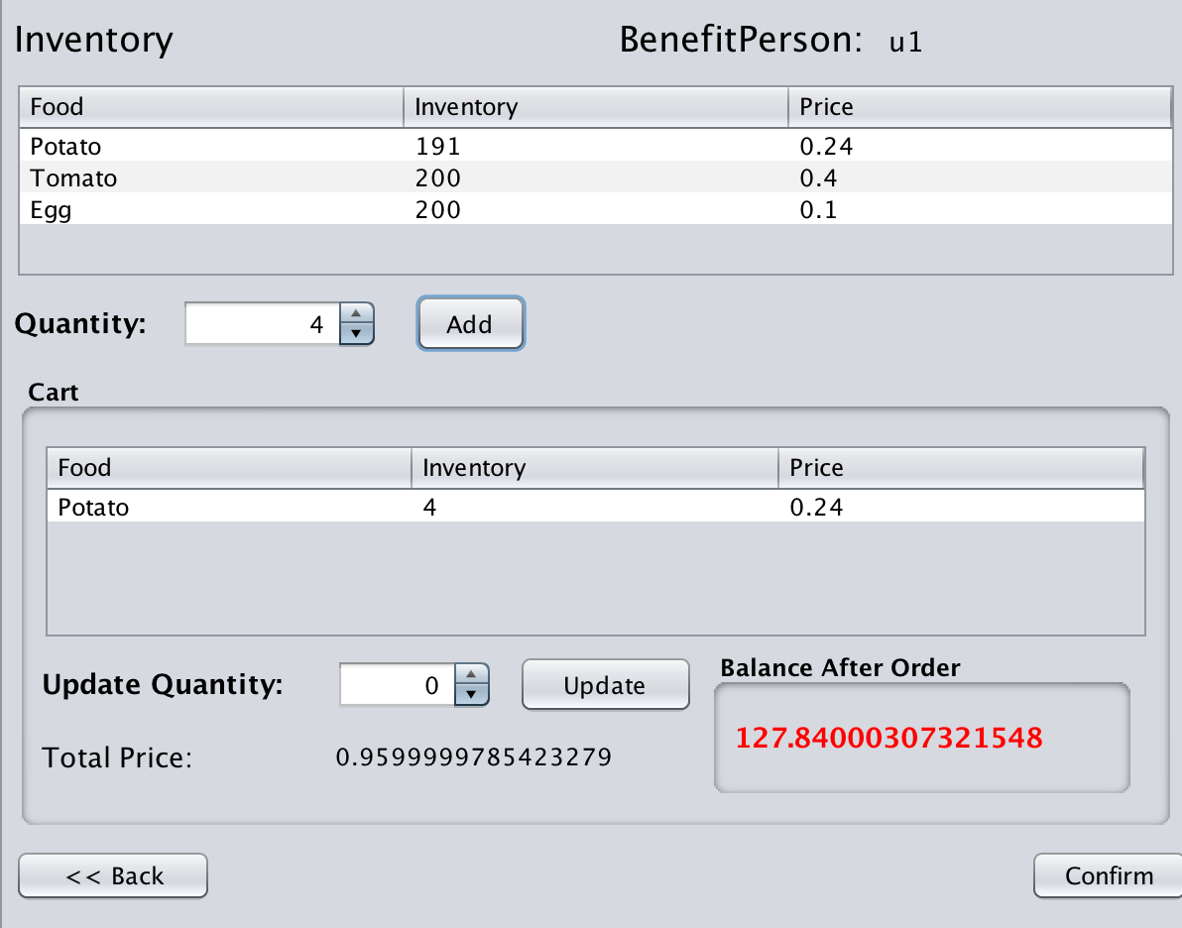
Service Role
Service role can search benefit person via SSN and see his/her balance
Service role can help benefit person by checkout their food

Slide 31
Thank you!

